Slide 1
High Frequency Trading and Mini Flash Crashes
Author: Anton Golub, John Keane, Ser-Huang Poon
Zhiwen Shen
2018.09.12

Slide 2
Table of Contents
Abstract
Introduction & Mini Flash Crash Definition
Research & Authentication
Dataset
Statistics on Mini Flash Crash & Definition of ISOs
Mini Flash Crash impact on market
Association with fleeting liquidity
Conclusion

Slide 3
Abstract
We analyze all Mini Flash Crashes (or Flash Equity Failures) in the US equity
markets in the four most volatile months during 2006-2011. In contrast to previous
studies, we find that Mini Flash Crashes are the result of regulation framework and
market fragmentation, in particular due to the aggressive use of Intermarket Sweep
Orders and Regulation NMS protecting only Top of the Book. We find strong
evidence that Mini Flash Crashes have an adverse impact on market liquidity and are
associated with Fleeting Liquidity.
Key words ：Mini Flash Crash / Intermarket Sweep Orders (ISOs) / market liquidity

Slide 4
Introduction
May 6th 2010 Flash Crash
HFT Generated a “hot-potato” volume accelerating mutual fund's sell side pressure and contributing to the sharp price declines
............
Trading aggressiveness was significantly higher for that entire day, proxied by the use of ISOs.
HFTs can process information on stock values faster than slow traders, adverse selection could lead to systemic risk events, such as the May 6th 2010 Flash Crash

Slide 5
Mini Flash Crash Definition
Down Crash
Up Crash
It has to tick down at least 10 times before ticking up
Price changes have to occur within 1.5 seconds
Price change has to exceed -0.8%
It has to tick up at least 10 times before ticking down
Price changes have to occur within 1.5 seconds
Price change has to exceed 0.8%

Slide 6
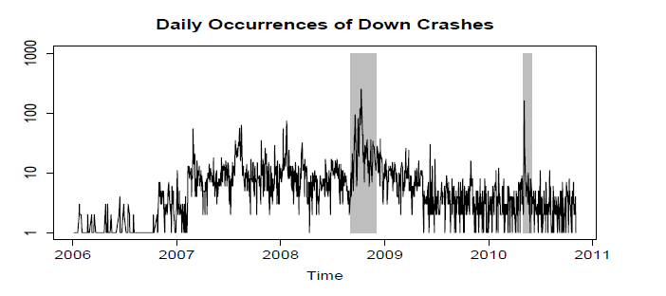
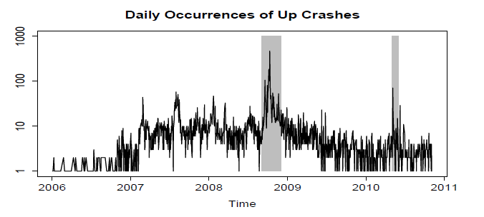
Dataset
The corresponding periods were highly volatile including the unfolding of the global financial crisis, and the collapse of Lehman Brothers and the May 6th 2010 Flash Crash.
Analysis of Mini Flash Crashes means processing billions of trades and quotes, therefore we selected months with the most crashes - hence our dataset covers over one-quarter (27.75%) of all Mini Flash Crashes reported to have occurred in the period of 2006-2011.

Slide 7
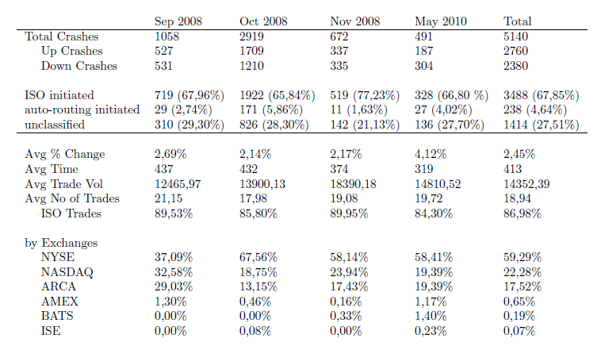
Statistics on Mini Flash Crash

Slide 8
ISO-initiated Mini Flash Crash
The conditions defining a Mini Flash Crash set out previously must be satisfied
The trades constituting the Mini Flash Crash have to be marked ISO, except for the rest k trades that can be marked as non-ISO if they are executed within the least aggressive market-wide available best quotes10 in the previous one (1) second.

Slide 9
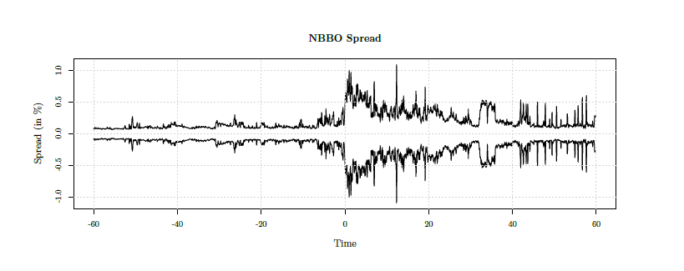
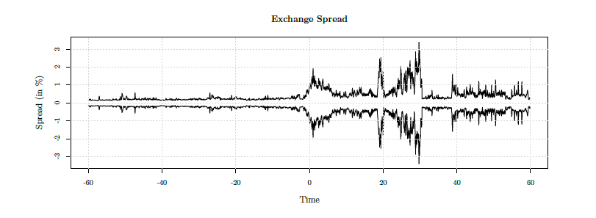
Market liquidity 60 sec before and after the occurrence of Mini Flash Crashes

Slide 10
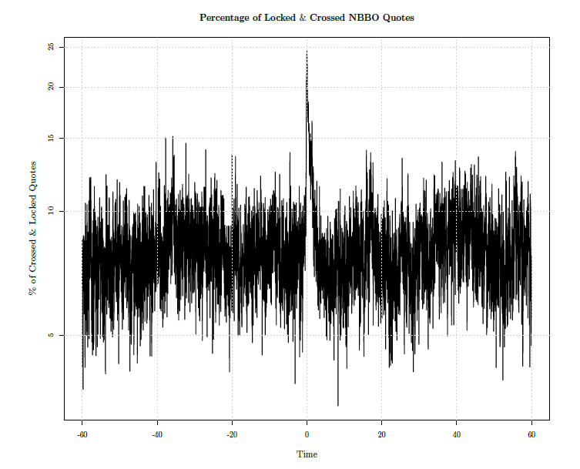
Locked & Crossed NBBO Quotes

Slide 11
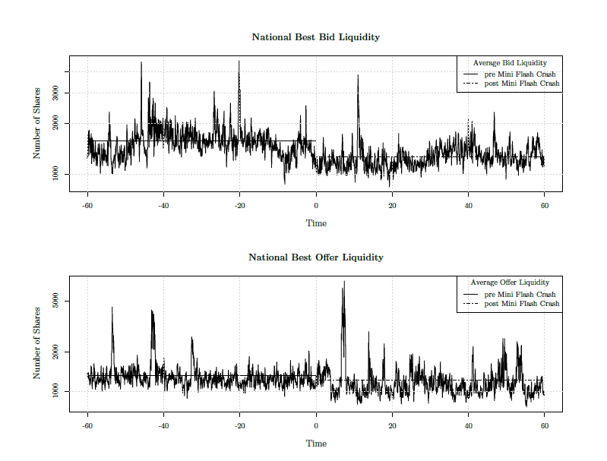
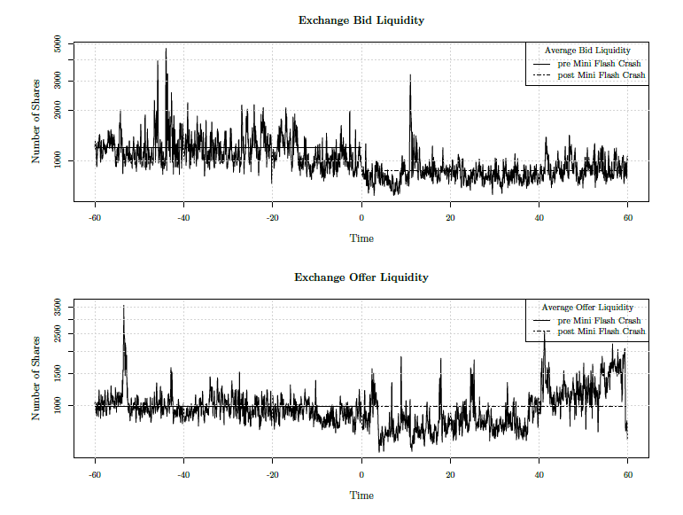
Quoted Volume

Slide 12
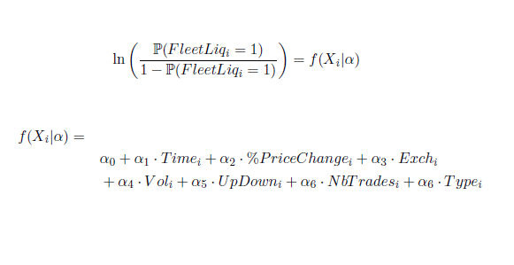
Connection – Fleeting Liquidity & Mini Flash Crash

Slide 13
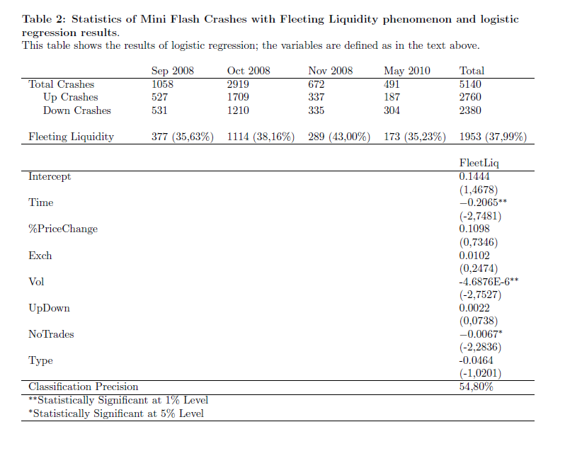
Logit Regression Statistics

Slide 14
Conclusion
In this article we analyze Mini Flash Crashes in US equity markets.
We find that Mini Flash Crashes are the result of regulatory framework and market fragmentation; in particular due to aggressive use of Intermarket Sweep Orders.
We find that Mini Flash Crashes have an adverse impact on market liquidity resulting in wider spread, increased number of locked and crossed NBBO quotes and decrease in quoted volume. Finally, we document the phenomenon of Fleeting Liquidity associated with ultra-fast crashes Mini
Flash Crashes of small volume, and a small number of trades.

